Slide 1
Go-Learn-Grow A Toolkit for Improving Attendance in
Pre-Kindergarten and Kindergarten
Notes:
Like all states in the country, New Jersey schools continue to work on the challenge of improving school attendance. Our dedication to that work includes our youngest students in our early childhood education programs.
Today we will talk about the importance of attending school every day and how staff in districts, schools, and early childhood program providers across NJ can work with parents and families to prevent chronic absenteeism.

Slide 2
Agenda
Describe chronic absenteeism, causes, and the relationship between attendance in the early grades and student outcomes
Discuss the New Jersey context and background
Provide an overview of New Jersey’s attendance toolkit and how you can use it
Q&A
Notes:
Describe chronic absenteeism, causes, and the relationship between attendance in the early grades and student outcomes
Discuss the New Jersey context and background
Provide overview of New Jersey’s new toolkit and how it can be used by schools and districts in NJ as well as other states who are aiming to decrease chronic absenteeism in the early grades.
Q&A

Slide 3
What is chronic absenteeism?
When children miss 10% or more of the school year, research suggests it is harder for them to develop a strong foundation for learning.
Being absent 2 or more days a month can add up to missing 10% of the school year.
Notes:
So, first of all, we understand attendance but do we have a clear vision of what chronic absenteeism is and why it matters?
Chronic absenteeism is defined as missing 10 percent or more of school days. In New Jersey, this means missing 18 days or more each school year, or about 2 days per month. Chronic absenteeism is particularly high for pre-kindergarten and kindergarten children compared with students in other elementary and middle school grades. A recent report revealed that 11 percent of kindergarten students in New Jersey were chronically absent in the 2015–2016 school year.
In order for young child to succeed in school and develop a strong foundation for learning, it is important that they attend school regularly.

Slide 4
Factors that contribute to absenteeism in the early years
Lack of value placed on early learning, compared to the upper grades
Student health conditions
Family obligations or schedules
Transportation challenges
Unstable housing
Stressful life events
Once schools identify students who need support, they can gather information about root causes and identify interventions to increase attendance.
Notes:
Bringing awareness to chronic absenteeism in the early grades is especially important since parents and educators may not value early learning as much as they value education in the higher grades. Missing school in Pre-Kindergarten and Kindergarten does matter – we’ll get into some of those reasons in the next few minutes.
A variety of other factors are also associated with chronic absenteeism, including…. [list on slide]
It seems obvious, but sometimes we focus on attendance numbers and we don’t always take active steps to learn 1) the students who miss school most often and 2) the specific reasons why these students are absent, so we can choose the best interventions to implement and ultimately try to improve attendance.
One way to increase attendance is to engage regularly with families about the importance of coming to school. When schools partner with families, they can help parents and other family members become advocates for ensuring children come to school every day, ready to learn. (This will tie in to next slide)

Slide 5
Missing school in the early years matters
Chronic absenteeism in the early grades is associated with:
Attendance issues in later grades
Lack of school readiness skills
Missing critical academic milestones
Future social-emotional and behavior problems
Grade repetition
Notes:
Regular school attendance in the early grades helps sets a strong foundation for learning and success in school. Habits start early for families and their children.
When students start attending school regularly in preschool and kindergarten, they are more likely to attend school regularly in later grades.
Chronic absenteeism early on, however, is associated with [list on the slide]

Slide 6
New Jersey is aware of the need to address chronic absenteeism
Legislation
Data reporting
ESSA indicator
Guidance for tracking and addressing chronic absenteeism K-12
Notes:
In NJ, accountability for chronic absenteeism is the law for K-12 schools.
In 2018, Governor Phil Murphy signed legislation that holds every public school accountable for reporting and remediating chronic absenteeism rates.
Every year the numbers must be reported to the State Board of Education and if the absenteeism rate is above 10% the district must develop a corrective action plan.
In addition to legislation and data accountability, like other states, we included the reduction of chronic absenteeism as an indicator in our ESSA plan.
The Division of Student Services issued guidance on tracking and addressing chronic absenteeism in K-12.
However, we know that the issues leading to absenteeism differ by age, so guidance for older children in the k-12 system is not likely to be the same for our youngest learners.
We believe it is valuable for us look at strategies to reduce absenteeism that may be particularly useful for children in pre-K and kindergarten vs. older students.

Slide 7
New Jersey’s growing need to address chronic absenteeism in early childhood programs
The state made a major commitment and investment in expanding our preschool programs. We want our 3, 4, and 5-year-old children to have opportunities to attend and flourish in high-quality early childhood education programs.
However, they must be at the program to benefit from the program.
High rates of chronic absenteeism in pre-K and kindergarten suggest that some problems—and perhaps some solutions—are unique for our youngest students.
NJDOE has issued guidance on tracking and addressing chronic absenteeism in K-12.
Now we have developed a toolkit of resources to highlight the attendance issue in preschool and kindergarten.
Notes:
We want to provide districts with something of a prequel to their elementary attendance efforts so that they can build a plan that anchors good attendance from preschool into K-12.
Our state is experiencing rapid growth in the number of districts offering pre-kindergarten programs. When districts apply for state funding, attendance data is collected and monitored. Our District Liaisons coach and counsel districts with high chronic absenteeism rates. We continue to monitor and support districts throughout annual assessments and reports. Therefore, we have a growing need to address attendance in the early years.
In our state, and surprisingly across the nation, our research indicated that there were very few support tools for districts to build and remediate effective attendance programs in pre-K and Kindergarten. We strongly believe that families are the critical, yet missing, partner in schools’ student attendance plans. Therefore, we built on that belief and our toolkit will serve as the foundation for supporting and inspiring districts to approach student attendance differently.
That is why the Division of Early Childhood Education created a toolkit of resources and highlight specific issues to consider in addressing chronic absenteeism in Preschool and Kindergarten.

Slide 8
Go-Learn-Grow Toolkit
Toolkit’s objectives:
Help educators and families understand the importance of attendance in early grades
Encourage schools to gather and include data on preschool students when reporting chronic absenteeism rates on school report cards
Help schools identify reasons for absenteeism
Provide guidance on selecting and implementing research-based strategies to improve attendance
Notes:
The REL and NJDOE worked together to create a toolkit of resources with the aim to:
Encourage schools to gather and include data on preschool students when reporting chronic absenteeism rates on school report cards
Help parents understand the importance of attendance in early grades
Help schools identify reasons for absenteeism
And Provide guidance on selecting and implementing research-based strategies to improve attendance

Slide 9
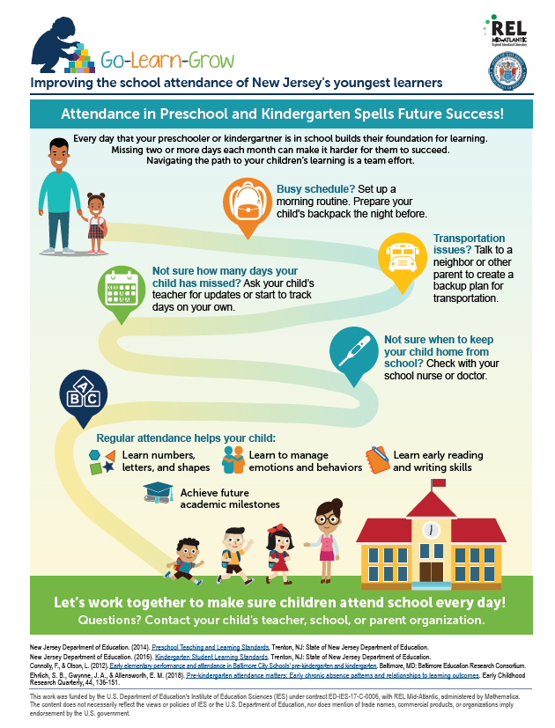
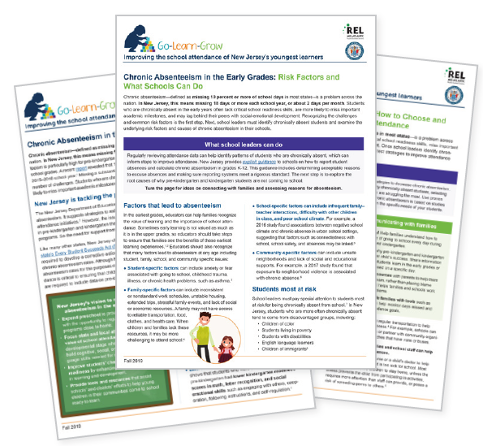
Go-Learn-Grow Toolkit Components
Provide specific resources and handouts to support districts, schools, early childhood providers, and parents:
Fact sheet series for district and school leaders
Infographic (flyer) for families
Slide deck and handout for school leaders to use with families
List of references and resources
Notes:
The toolkit includes resources for everyone, including staff in districts, schools, and early childhood providers, as well as families and parents:
A series of 3 fact sheets intended for school and district leaders to use with educators and other staff
A user friendly infographic (or flyer) aimed at families that can be posted on walls of schools and early childhood providers
A slide deck with an accompanying handout for educators and school leaders to use in parent meetings
Full list of citations of all the research we used and cited when developing the toolkit, as well as a list of helpful resources to decrease chronic absenteeism
The idea is that these materials will be accessible to use together or individually as a tool to support those working to reduce chronic absenteeism in the early grades. We will provide the links to these materials at the end of the presentation.
The materials are currently aimed at educators and parents in NJ, but can be downloaded and used by districts and schools in other states. If needed, you can rebrand materials for use with parents and educators in your community. For more information, please contact us.
Now that you have an overview of the toolkit, we’ll discuss the components and their contents in more detail.

Slide 10
Resources for Districts, Schools, and Early Childhood Providers
Notes:
The first set of materials are fact sheets aimed at district and school leaders and staff, as well as ECE providers.

Slide 11
Fact Sheet 1: Chronic Absenteeism in the Early Grades: A Snapshot of New Jersey
Intended audience:
District and school staff, early childhood education providers
Aims:
Define chronic absenteeism and provide information about the importance of addressing the issue during the early years
Describe steps New Jersey has taken and its vision moving forward
Notes:
The first fact sheet “Chronic Absenteeism in the Early Grades: A snapshot of New Jersey” is aimed towards district and school staff as well as ECE providers. The fact sheet aims to:
Define chronic absenteeism and provide information about the importance of addressing the issue during the early years and
Describe steps New Jersey has taken and their vision moving forward
Earlier we discussed the importance of attendance during the early grades, and how chronic absenteeism in pre-kindergarten and kindergarten is associated with poorer school outcomes as children transition through school. We won’t go over this research again now, but this part of Fact Sheet 1 is relevant to schools and districts across the country who are aiming to help school leaders understand the importance of school attendance during the early years.

Slide 12
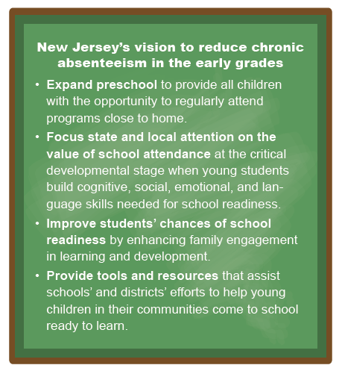
Fact Sheet 1: Chronic Absenteeism in the Early Grades: A Snapshot of New Jersey
Notes:
This first fact sheet also specifically highlights New Jersey’s vision to reduce chronic absenteeism in the early grades which include: expanding preschool to all children, focusing state and local attention on the value of attendance, improving students’ chances of school readiness, and providing tools and resources to help schools’ and districts efforts to help children in their community come to school ready to learn.
This box shows the importance of these issues in NJ and could be tailored for use in other states.

Slide 13
Fact Sheet 2: Chronic Absenteeism in the Early Grades: Risk Factors and What Schools Can Do
Intended audience:
District and school staff, early childhood education providers
Aims:
Increase awareness of factors associated with missing school and chronic absenteeism
Help schools target services to students most at risk for chronic absenteeism
Show school leaders and other educators how to:
Identify students and assess patterns
Connect with parents and families
Notes:
The second fact sheet “Chronic Absenteeism in the Early Grades: Risk Factors and What Schools Can Do”:
Highlights common factors associated with missing school and chronic absenteeism
Helps schools and districts identify students most at risk for chronic absenteeism, and
Shares information about what school leaders and other educators can do, including:
Strategies they can use to identify students most at-risk and assess patterns of absenteeism
Ways to connect with parents and families

Slide 14
Fact Sheet 2: Chronic Absenteeism in the Early Grades: Risk Factors and What Schools Can Do
Connecting with families is critical
Schools can:
Help families see the value of school attendance
Gather information to understand attendance challenges and link families with resources
Educators should begin conversations with families early and engage regularly about the importance of attendance during:
Pre-kindergarten and kindergarten registration
Open houses and back-to-school nights
Parent–teacher conferences
Conversations designed to get to know the children and families
Notes:
We’ve already shared some of the risk factors for chronic absenteeism that are highlighted in this fact sheet. This fact sheet also emphasizes the importance of connecting with families.
Schools can: (Talk through/discuss bullets on slide)
This fact sheet also describes the importance of beginning conversations with families early and continuing these conversations regularly. These conversations may happen during: (Talk through/discuss bullets on slide)

Slide 15
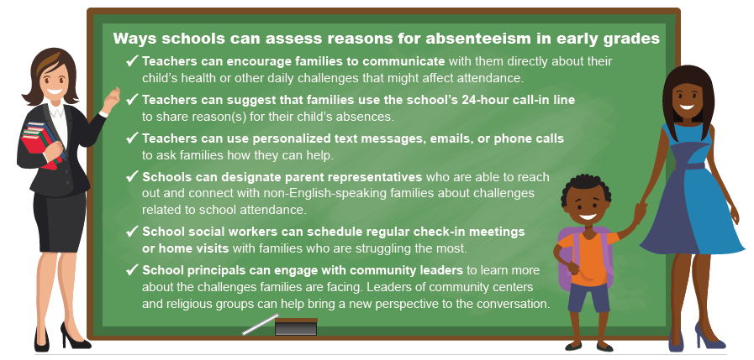
Fact Sheet 2: Chronic Absenteeism in the Early Grades: Risk Factors and What Schools Can Do
Notes:
Schools can choose from a variety of possible techniques to identify why young students in their school may be chronically absent including: (Talk through/discuss bullets on slide)
Once schools identify students who need support and gather information about root causes, the next steps are to identify, implement, and evaluate interventions to reduce rates of chronic absenteeism. (this will help tie it to next slide)

Slide 16
Fact Sheet 3: How to Choose and Implement Proven Strategies to Improve Attendance
Intended audience:
District and school staff, early childhood education providers
Aims to help education leaders:
Select the right strategy or intervention
Communicate with families
Build community partnerships through resources
Implement and test strategies
Expand the range of proven strategies
Notes:
The third fact sheet “How to Choose and Implement Proven Strategies to Improve Attendance” aims to help districts and schools:
(Talk through/discuss bullets on slide)

Slide 17
Fact Sheet 3: How to Choose and Implement Proven Strategies to Improve Attendance
Research shows that:
Informing families about the importance of attendance in the early grades can improve attendance.
Post messages on public buses or use recorded wake-up calls
Send postcards or text messages to parents
Offering transportation alternatives can help get children to school.
Help arrange walking school buses or partner with community organizations that have vans or buses
Coordination between families and school staff can reduce illness-based absences.
Help parents understand which symptoms necessitate staying home
Use preventive measures such as helping children wash their hands and cover their mouths
Work with students who have a chronic illness to determine what supports schools might provide
Notes:
Some of the highlighted research in this third fact sheet suggests that:
Informing families about the importance of attendance in the early grades can help improve attendance rates. (Describe research)
Offering transportation alternatives can help get children to school. (Describe research)
Coordination between families and school staff can help decrease illness-based absences. (Describe research)

Slide 18
Fact Sheet 3: How to Choose and Implement Proven Strategies to Improve Attendance Part 1
Implementing and testing strategies
Test whether strategies are being implemented as expected and determine how well they are working
Help inform changes to your strategy and provide important information about what works for improving attendance for young learners
Notes:
This third fact sheet also gives tips for implementing and testing strategies. It’s important to observe and test strategies to make sure they are being implemented as expected and to understand how well they are working. Testing strategies can also help inform changes along the way to maximize the chance to improve attendance for young learners.

Slide 19
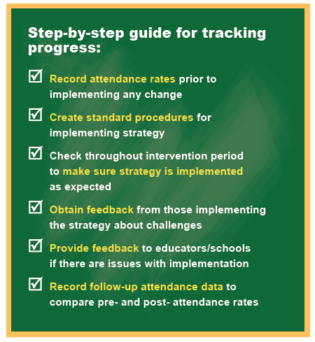
Fact Sheet 3: How to Choose and Implement Proven Strategies to Improve Attendance
Notes:
We recommend a step-by-step approach to track and test progress. (Talk through/discuss bullets on slide using some concrete examples)
We are still learning about ways to combat chronic absenteeism in the early grades. Testing new strategies can provide important information for all of us about what works (and doesn’t work) for improving attendance for young learners.

Slide 20
Resources for Parents and Families
Notes:
In addition to the fact sheets that are meant for education leaders and early childhood stakeholders, we also created user-friendly materials targeted directly at parents and families.

Slide 21
Resources for parents and families: Infographic
The infographic is available in English and Spanish.
Notes:
We created a user friendly infographic that schools can use to help schools and teachers work with parents to make sure the youngest learners attend school regularly.
This flyer shows why attendance during the early years is important and how families can work with schools to reduce chronic absenteeism. It provides schools and early childhood providers with a stand-alone resource that can be easily disseminated by posting it on bulletin boards or walls of schools, sending home with children, or by sharing with community agencies. This flyer is also available in Spanish.

Slide 22
Resources for parents and families: Slide deck with handout
The handout is available in English and Spanish.
Notes:
We also prepared a slide deck with talking points and a corresponding handout designed for school leaders and staff to use in talking directly with parents and families.
We encourage school staff to use this slide deck and the suggested talking points during parent meetings and other events, personalizing it based on the school’s policies and procedures.
The corresponding one-page handout ‘Preschool and Kindergarten Attendance Can Spell Success!’ can be shared with parents and families when delivering the presentation or during other types of parent and family school meetings, such as parent-teacher conferences. This flyer is also available in Spanish.

Slide 23
Conclusions and next steps
NJDOE and REL Mid-Atlantic have partnered to create this toolkit as a companion resource to New Jersey’s existing K-12 guidance.
The toolkit can support districts, schools, and early childhood providers in improving school attendance in pre-K and kindergarten in New Jersey and beyond.
Now it’s your turn! Help us put these materials to use with district leaders, school staff, early childhood education professionals, and families.
Notes:
We developed this toolkit as a companion resource to New Jersey’s existing K-12 guidance, with the goal of highlighting the issue in the early grades.
You can use the toolkit materials to support districts, schools, and early childhood providers in improving school attendance in pre-kindergarten and kindergarten in NJ and beyond.
Now it’s your turn! Help us put these materials to use with district leaders, school staff, early childhood education professionals, and families.

Slide 24
Questions and Answers

Slide 25
Questions? Reach out!
New Jersey Department of Education, Division of Early Childhood Education
doeearlychild@doe.nj.us
REL Mid-Atlantic
RELmidatlantic@mathematica-mpr.com

